Slide 1

Encode Club – zkML Bootcamp – Q1 - 25
Group 5 Team
V6ixnR - @blewater
XcDfTp - @Panos Matsinopoulos
xW7r5t - @vivi
RbWStu - @SarthiB7
nw4Mit - @arcadiogm#
TxDLjI - @Horlarmmy
YC9ZTb - @Haseeb Raja

Slide 2

PoC – Proof of Concept >>> Summary / Purpose statements
Example
The Project is a game of where a user can select 6 numbers of their choice during the duration of the current Lotto Game week.
At the end of the Game week, the game ends by end of day 6 of the start of the current game and the Lottery Winning numbers are randomly generated.
The user with the winning lotto entry will verify their valid lotto numbers and be able to claim their winnings.
New game starts at end of day 7 of previous game week start

Slide 3
Technology >>>
EXAMPLE
Constant-Sized Blockchain (22k)
Efficient verification
Decentralization
Security and Privacy

Slide 4
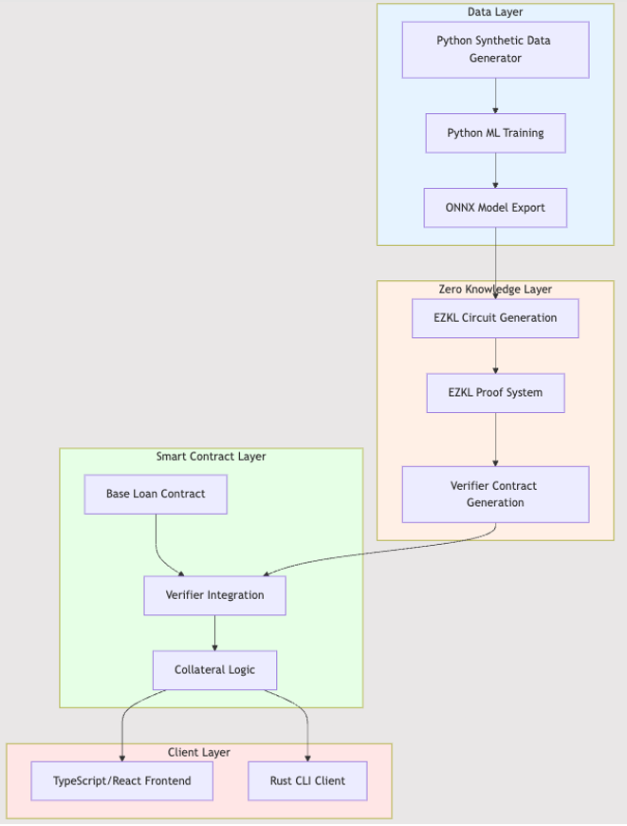
PoC – Proof of Concept >>> Diagram
Comments:
The idea is to provide a general description of the entire process in blocks, without needing to go into detail... this will be done in the following slides...
GitHub Repo:
https://github.com/Loan-ZKML/Ezkl-ML

Slide 5
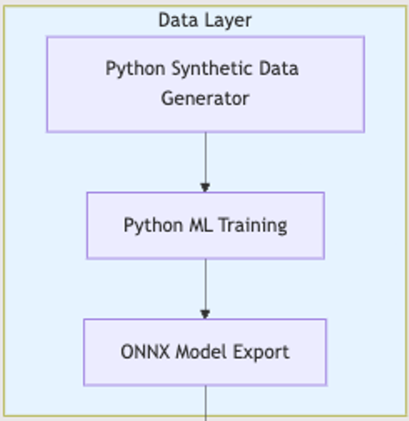
PoC – Proof of Concept >>> Diagram >>> Data layer
Comments:
The idea is to provide a more detailed description of this part of the process, including its functionality, including the main (software) features, and where it can be found in the GitHub repository......
EXAMPLE Functions:
init() -> initialize ZKLottoGame contract
startLottoWeek() -> start new lotto week
GitHub Repo:
https://github.com/Loan-ZKML/Ezkl-ML/tree/main/synthetic_data

Slide 6
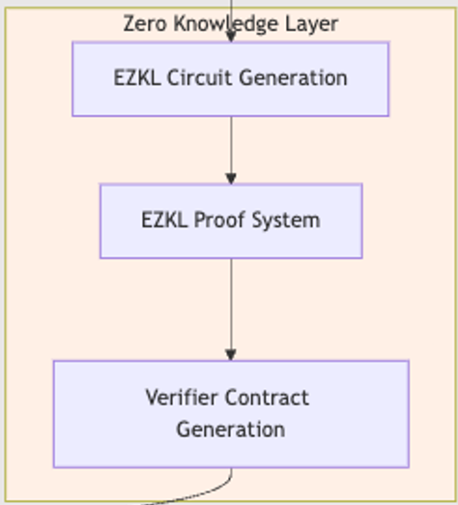
PoC – Proof of Concept >>> Diagram >>> ZK Layer
Comments:
The idea is to provide a more detailed description of this part of the process, including its functionality, including the main (software) features, and where it can be found in the GitHub repository......
EXAMPLE Functions:
init() -> initialize ZKLottoGame contract
startLottoWeek() -> start new lotto week
GitHub Repo:
https://github.com/Loan-ZKML/Ezkl-ML

Slide 7
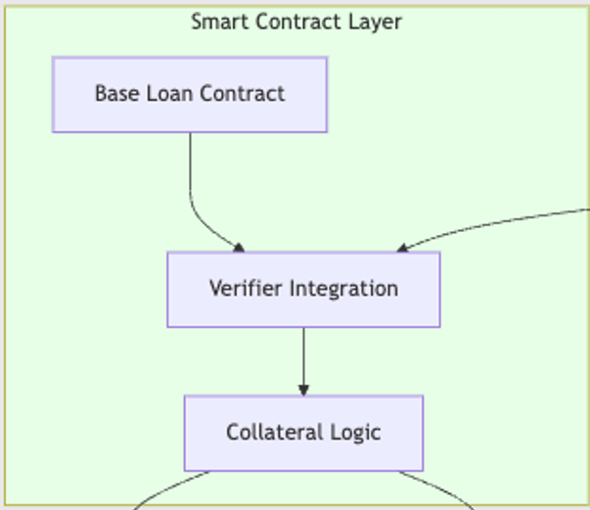
PoC – Proof of Concept >>> Diagram >>> Smart Contract Layer
Comments:
The idea is to provide a more detailed description of this part of the process, including its functionality, including the main (software) features, and where it can be found in the GitHub repository......
EXAMPLE Functions:
init() -> initialize ZKLottoGame contract
startLottoWeek() -> start new lotto week
GitHub Repo:
https://github.com/Loan-ZKML/Ezkl-ML

Slide 8
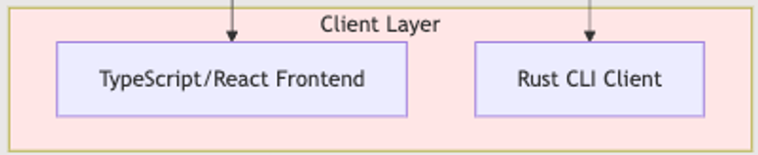
PoC – Proof of Concept >>> Diagram >>> Client Layer
Comments:
The idea is to provide a more detailed description of this part of the process, including its functionality, including the main (software) features, and where it can be found in the GitHub repository......
EXAMPLE Functions:
init() -> initialize ZKLottoGame contract
startLottoWeek() -> start new lotto week
GitHub Repo:
https://github.com/Loan-ZKML/Ezkl-ML

Slide 9
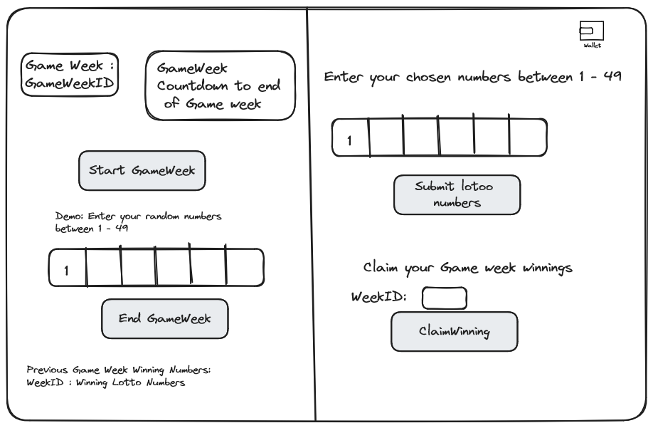
PoC – Proof of Concept >>> Front-End

Slide 10
PoC – Proof of Concept >>> Logic
Logic:
ABC…

Slide 11
Encode Club – zkML Bootcamp – Q1 - 25
Thank you!

